Slide 1
Wrapping up UI design
Lecture #5

Slide 2
Scaffold

Slide 3
Scaffold
You have surely used scaffold widget in your apps. A scaffold handles for us the following -
AppBar
Body
Floating Action Button
Bottom Navigation Bar
drawer
Persistent footer buttons

Slide 4
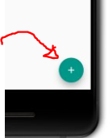
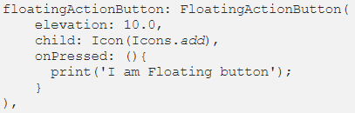
Scaffold: Floating Action Button
We make use of the floatingActionButton property:
You can change the button location using floatingActionButtonLocation property of scaffold.

Slide 5
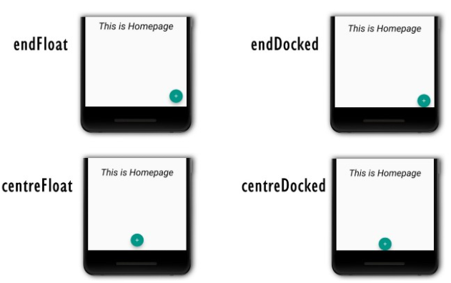
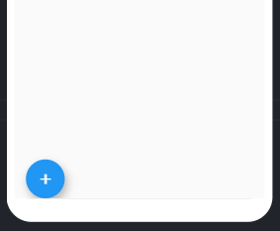
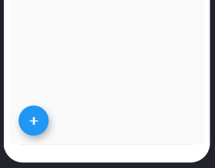
Scaffold: Floating Action Button
StartDocked
StartFloat

Slide 6
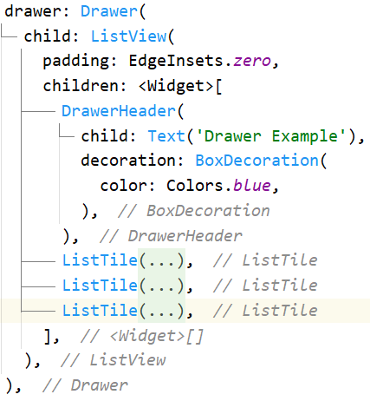
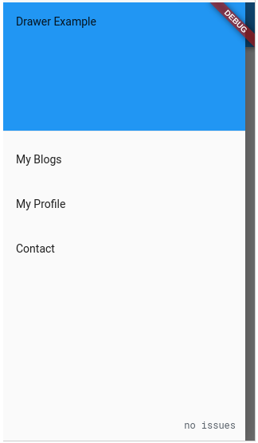
Drawer

Slide 7
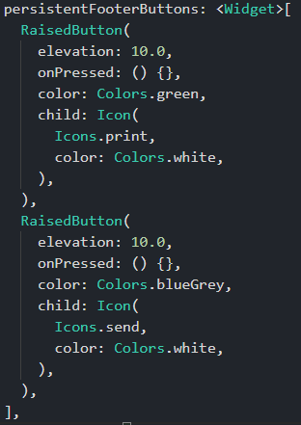
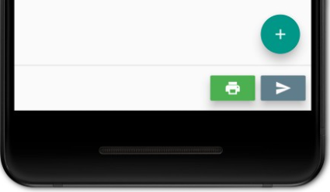
Persistent Footer Button

Slide 8
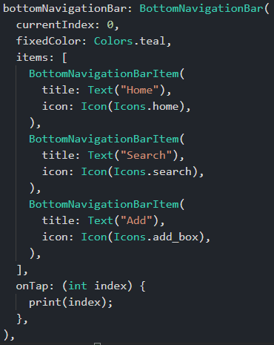
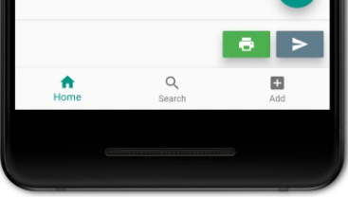
Bottom Nav Bar

Slide 9
Bottom Nav Bar
But of course it does nothing but to print the index.
To update selected Nav bar item in the UI, we need a StatefulWidget
StatefulWidget has a setState method that updates necessary parts of the UI.
setState method calls the build() method
Whenever a change takes place, setState method only update the parts of the UI affected by the change

Slide 10
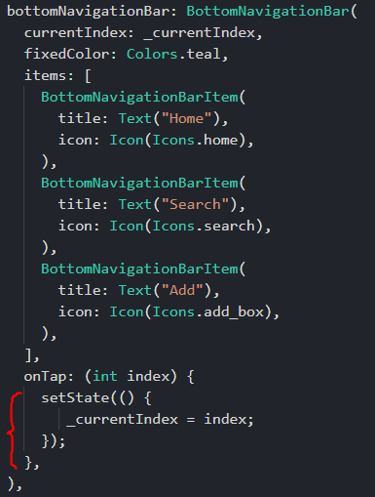
Bottom Nav Bar
If you are created a stateless widget like I have, then place your cursor on StatelessWidget, press alt+enter, and select convert to statefulWidget
Init currentIndex value with a local variable _currentIndex.
Set initial value of _currentIndex
Update the value of _currentIndex on tap and call setState to reflect the change in UI

Slide 11
BuildContext

Slide 12

BuildContext
You might have noticed BuildContext in the build method
BulidContext is a handle to the location of a widget in the widget tree.
It gets passed to the builder of a widget in order to let it know where it is inside the widget tree of your app.
Calling Something.of(context) returns the Something relative to the closest widget in the tree that can provide you Something.
For example, calling Scaffold.of(context) returns the Scaffold nearest to the widget with the provided context in the widget tree.

Slide 13
Forms

Slide 14
Forms
First, create a Form. The Form widget acts as a container for grouping and validating multiple form fields.
When creating the form, provide a GlobalKey. This uniquely identifies the Form across the entire app, and allows validation of the form in a later step.
Here, “Formstate” is standard for any form regardless of what widget/variable name you select.

Slide 15
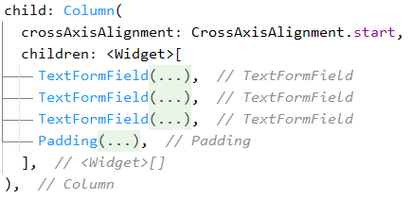
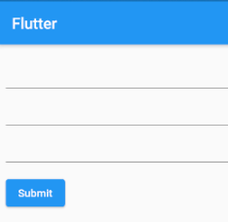
Forms

Slide 16
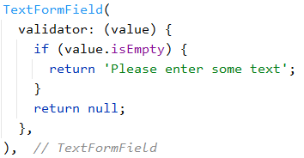
Forms
This is one of the text fields.
Implement validation checks in validator function
“Value” is the string value typed at that moment
Return the error message.
Returning null means the value is valid

Slide 17
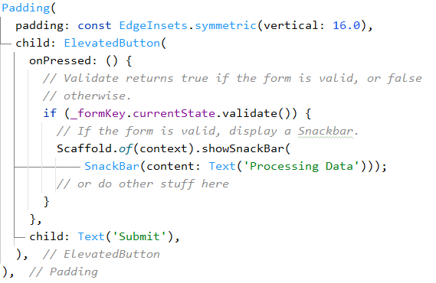
Submit button
_formKey.currentState.validate() calls all validators.

Slide 18

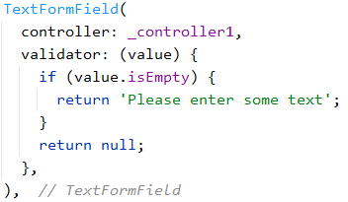
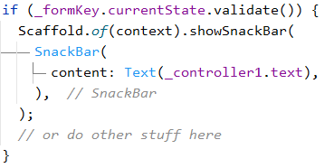
Text editing controller
We can use a TextEditingController for features like setting initial text, accessing field’s value, etc.

Slide 19
Boss level challenge

Slide 20
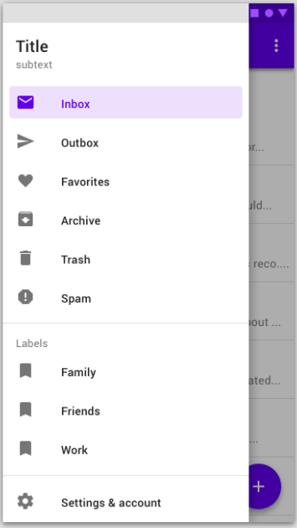
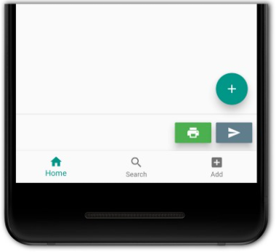
Boss level challenge

Slide 21
Ultra Boss level challenge (Module test)

Slide 22
Module test: Instructions
This test will test everything you have learnt up to this point.
The challenge may seem difficult if you are not clear with ideas and topics taught up to this point
If you are unsure, you can always review the slides, the documentations on flutter.dev and the quick docs from android studio
All the best!

Slide 23
Module test
We are going to design an group chatting app of our own!
For this test, you will design -
Welcome screen
login page
Signup page
Group chat screen
My accounts page (A page displaying user photo, name, and status. Include a floating button with “edit” icon on it)

Slide 24
Module test
You are suggested to use any app(s) of your choice (like skype, messenger, whatsapp, etc.) for motivation.
Or head over to dribbble.com to find more design inspiration
Remember that you don’t need to add ANY functionality at this point. We will implement them later.
Here are some sample pages for reference

Slide 25
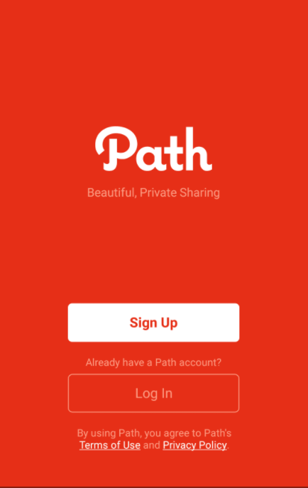
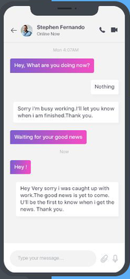
Module test
Welcome screen Group Chat screen

Slide 26
Good Luck!

